Slide 1
MSDS 610 Wk 2
Dataset and MLS
Kyle Mellors

Slide 2
Dataset Overview
This dataset is an accumulation of 20 features* that give a detailed background on 5,000 movies from The Movie Database. This information includes, but is not limited to, the budget, genre, language, popularity, run time, popularity, vote counts, and more.
Location: https://www.kaggle.com/datasets/tmdb/tmdb-movie-metadata?select=tmdb_5000_movies.csv
*The data set contains two .csv files, totalling 24 features, but the first file - which only has 4 features - contains unique ID information, that I would not need for my MLS.

Slide 3
Dataset Description
Budget (Continuous): How much it cost the company to make the film.
Genre(s) (Nominal): The genre(s) the film was classified as at release.
Homepage (Nominal): the website curated for the film.
ID (Nominal): A unique identifier number specific to the film.
Keywords (Nominal): Specific words associated with the film.
Original Language (Nominal): The specific language of the film’s location.
Original Title (Nominal): The working title given to the film.
Overview (Text): A summary of the plot of the movie.
Popularity (Continuous): A rating attribute based on user metrics.
Production Companies (Nominal): The company that paid for the production.

Slide 4
Dataset Description (Cont’d)
Production Countries (Nominal): The country of the production company.
Release Date (Continuous): The date that the film was released to the public.
Revenue (Continuous): The films box office performance and earnings.
Run Time (Continuous): How long the film is from beginning to end.
Spoken Languages (Nominal): The language(s) spoken in the film.
Status (Categorical): Release status at time of collection (released, post production, rumored)
Tagline (Text): Elevator pitch of the film.
Title (Nominal): The title of the film at release.
Vote Average (Continuous): The average rating (1-10) of the voter ratings.
Vote Count (Continuous): The # of users who ranked the movie.

Slide 5
MLS Problem
Business Overview: A production company who invests funds (budget) into a film with the expectation on a return-on-investment, the ROI is based on the revenue of the film’s box office run. Additionally, popularity and ratings are important to help identify if an incoming script has the potential for a high ROI.
Business Problem: The company found itself in a situation where the funds they have been investing have not had a good ROI. Therefore, the business is looking to build a recommender system that could take the information of the potential film (such as the genres, tag line, potential budget, summary, etc.) to make a recommendation on whether the company should invest in the production of the film.

Slide 6
MLS Flowchart
5. Monitor & Maintenance
The system should be regularly monitored for effectiveness by comparing its recommendations against the actual ROI of the films that were proposed. Additionally, the dataset should continue to be updated as recent movie data is released and available to train the model.
01
1. Data Collection
Collect data from available films, with a focus on budget, revenue, genres, keywords, summaries, taglines.
05
02
2. Data Processing
Clean the extract the useful features and clean the data. Find feature importance. Create a ROI feature (does revenue exceed budget by 2.5%?). Focus on developing emerging themes.
4. Deployment
Run the model anytime a film investment proposal is delivered. The proposals should include estimated budget (investment requested), tagline, genres, summary, and keywords. The model will recommend whether the investment company should invest in the production of the film, or not.
02
04
03
3. Model Training
Create a categorical predictive model w/ a recommender system: Is Revenue at least 2.5% Budget? Yes = Recommend, No = Do Not Recommend. Include a print out of similar movies (to compare features).

Slide 7
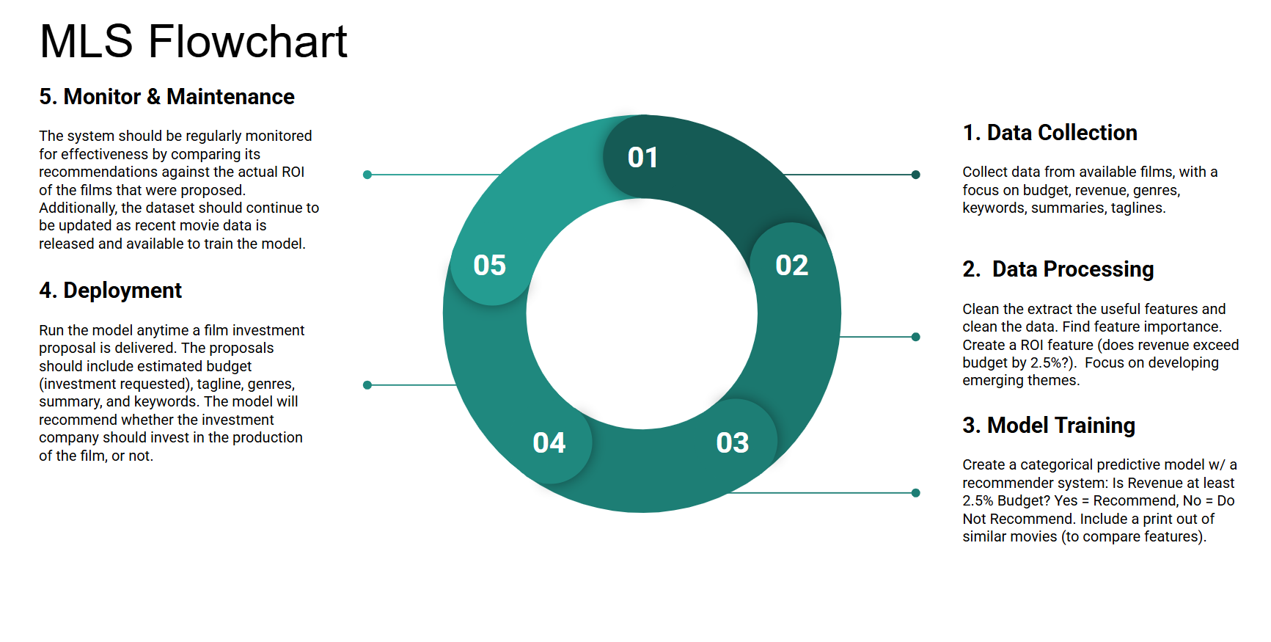
MLS Flowchart Image
Including an image of my MLS flowchart, since I am using Google Slides and I am not sure if the chart template I used will translate to your .pptx source.

Slide 8
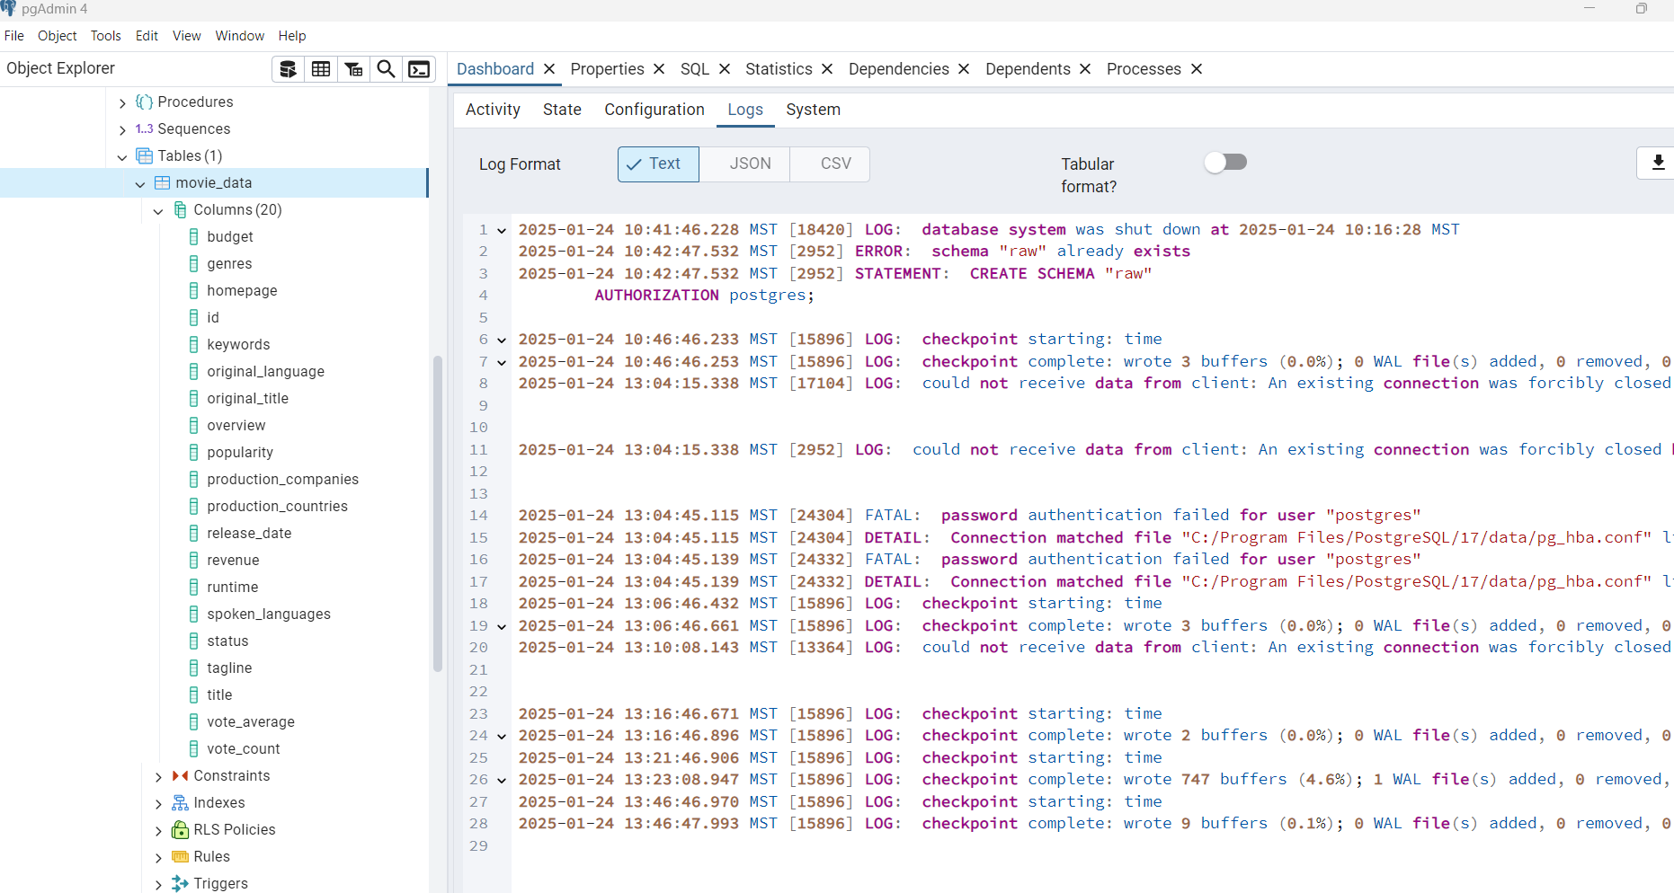
PgAdmin Data Image

